Slide 1
Public Procurement
International Trends and Roadblocks
Paul Schapper
2015

Slide 2
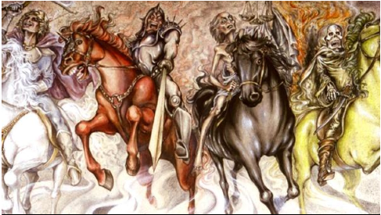
The Dismal Science
Economics or Procurement?
Both are based as much on myth as reality
Both are concerned with social welfare
Both are concerned with value and waste, and
Both deal with politics
Notes:
However, unlike economics, procurement is making some small steps in positive directions (mostly).
Corruption
Waste
Inefficiency
Misfit for purpose
politics

Slide 3
Why Procurement is Important
Government procurement is 15%-20% GDP (OECD)
Procurement account for 70% of budget (OECD)
Poor procurement can result in a country moving backwards (IMF)
Procurement links the public financial system with societal goals (World Bank)
This is difficult, most governments have not been fully successful

Slide 4
Many Procurement Developments
EU directives
WTO – GPA
MDBs CPARs etc
E-procurement
GAC
OECD toolkits
UNCITRAL Law
World Bank policy and procedures reform
Transparency International
UN procurement standards etc
New modalities – PPPs, FAs, etc
4 pillars reforms

Slide 5
Cuatro Modernizaciones en la Adquisiciones Publicas
Regulación
Instituciones
Profesionalización
Integridad
Notes:
cuatro modernizaciones en la contratación pública

Slide 6
Cumplimiento y Desempeño de la contratación
Standards de Gobernabilidad
Best value
Procurement
Proceso
Resultados
Tendencias Internacionales en Compras Públicas
The 4 pillars of reform
Institutional / Regulatory / Capacity / Integrity –
will not alone take us from here to there
Traditional
Procurement
.
Conformidad
Regulatoria
Notes:
Institutional
Regulation
Capacity
Integrity
Governments attempt to shift activities to private sector

Slide 7
Evolution of Procurement Reform
Many governments now preface their procurement laws with good procurement principles.
Procurement has gone from simple low value to complex high value and procurement methods are beginning to catch up
However, accountability in the majority of governments continues to be for compliance with procedures.
Life is complex - the needs of modern societies cannot realistically be addressed by a schedule of regulated clerical procedures.

Slide 8
Spend Analysis and Reform Agenda
Big business
Politics
80% of spend
Technical
Adquisiciones Estrategicas
80%
Complejidad y Riesgo
Framework Agreements
E-GP
Small business politics
20% of spend
Transactional efficiencies
Adquisiciones Simples
20%
Low Value Commodities
Spend
Notes:
Many governments now undertake spend analyses.
For auditors and investigators, it is relatively easy to identify low grade procurement fraud and corruption where there was a lack of compliance with rules or a lack respect for internal controls. It is far less likely that the misdirection of procurement related expenditure in major or complex contracts will be detected because auditors and investigators generally lack the knowledge and skill to recognise the “red” flags in this context.
These two areas (Simple vs Complex) are entirely different universes, but are usually under the same sets of procedures with relatively minor variation

Slide 9
Private Sector Reform Options
There have been some successful examples of reforms that have resulted in the introduction of public procurement practices that are like those that are common in the private sector.
However, unlike in the private sector, it is difficult in government to align corporate and individual interests. The performance-reward link hardly exists
Some governments have focussed on outsourcing to shift procurement problems to the private sector and hope for innovation and productivity

Slide 10
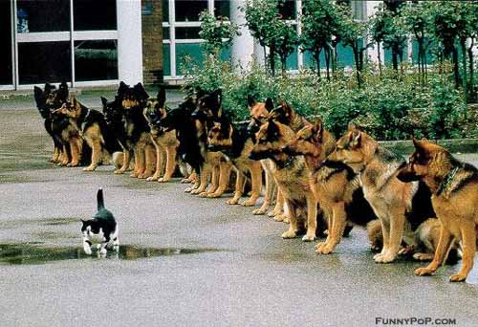
Outsourcing and PPPs
Complex procurement is sometimes outsourced – PPPs, etc
Outsourcing requires strong risk management
Governments that are not strong in procurement are unlikely to be strong in risk management
Notes:
There have been some successful examples of reforms that have resulted in the introduction of public procurement practices that are like those that are common in the private sector.
However, unlike in the private sector, it is difficult in government to align corporate and individual interests. The performance-reward link hardly exists
Some governments have focussed on outsourcing to shift procurement problems to the private sector and hope for innovation and productivity

Slide 11
Broad Reform Activity
Africa -
UNCITRAL regulations
Regulatory bodies
SBDs
Anti-corruption agencies
LAC -
Reformed laws
e-GP
Regulatory bodies
Asia -
Institutional strengthening
e-GP
New methods (eg FAs, PPPs)
BUT results have not been forthcoming, and legacy issues have remained mostly unchanged.
Notes:
Often the reformers don’t understand key aspects of procurement – Botswana, Mozambique, Kenya…

Slide 12
Law of Governance
Q: So what has gone wrong? New laws, new institutions, old performance
A common error is to presume that the Law can deliver good Governance
And that good governance delivers good procurement.
In reality, good Governance delivers good Law. The role of the Law is to specify accountabilities, not management.
Many (most?) governments continue to hold substantial political control over procurement management
Notes:
LAC (and EU) is under civil law – but so are all governments
We can have laws that require procurement planning. We cannot have laws that require good procurement planning

Slide 13
Challenges to New Reforms
Diminishing returns of generic fixes (4 pillars)
High value complex procurement – major gains require transformation of cultures and democracy itself
Politicians, policy makers, comptrollers
Private sector participants
Civil Society Groups – Beneficiaries
The never-never
plan
Forget system fixing
– focus on individuals
Customize governance and performance around agencies, companies and individuals for complex procurement

Slide 14
International lessons
Distinguish between complex vs simple procurement and understand the relevance of this to management and politics
Adopt a notion of ‘efficiency’ to include the concepts of outcomes rather than simply whether the processes themselves are efficient.
Focus on integrity and individuals rather than on institutions and law – simple procurement is about systems and institutions, complex procurement is about individuals
Refocus the law to provide accountability rather than control

Slide 15
Some Continuing Opportunities
Tools are becoming more widespread: PPPs, FAs, e-procurement. Also becoming harder for governments to hide poor practice (social media, etc)
Performance and risk-based dispute resolution (eg Kenya, Australia)
E-Procurement to focus on information rather than just transactions (everywhere)
Mandate framework agreements (ignore centralization vs decentralization, agency rivalry)
Review contract design (eg Zimbabwe)
Public performance standards for individuals and agencies (new frontier)
Notes:
Not all dismal science

Slide 16
Not All Dismal
Gracias
Notes:
Not all dismal science
Some positive examples – in even countries at very high risk Bangladesh IT project intensive planning, international research, good BDs, fast selection, good outcome US$150 million
Even robust governments have disasters – eg Australia, also NGOs impose disasters e-signature, monopoly suppliers, poor governance (eg WB in Africa no-one accountable)
In even the most difficult countries there are usually some individuals / agencies who are champions in procurement and will take risks to reform
Mongolia – roads program overseen by local communities
TRAI, Singapore, Denmark NZ

